Slide 1

Microbiological Testing of Foods: Sampling Plans

Slide 2

Product testing
Product testing by itself will NOT ensure a safe or quality product
Sampling does provide some assurance (evidenced by negative test results) that products are not adulterated
Used as a “verification” procedure
Verifies that the antimicrobial interventions are working to control the hazard
Notes:
Product testing by itself will not ensure a safe or quality product. (Animation) It does provide some assurances that your product is not adulterated. Ensuring that GMPs and your validated processes are followed are much better at indicators that your product will be of high quality and free of pathogens than final product testing. (Animation x2) Microbiological testing should be used as a verification that your GMPs and preventive controls are working as intended to keep microbial loads low and products pathogen free.

Slide 3

Design of a sampling plan
Try to find the problem (pathogen)
Easy to design a plan that will result in no or negative findings
In your best interest to find the pathogens before the contaminated product enters commerce
Impact on public health and the associated costs to your business
Detecting the pathogen is the desirable outcome of a well-designed and executed sampling program
Notes:
A processor needs to think critically when designing a sampling plan. An effective sampling plan is one that tries to find the problem, i.e. a pathogen. (Animation) Very easy to design a microbial sampling plan that will never find a pathogen in your product. (Animation) It is in your best interest to catch contaminated product before it enters commerce. No one wants to put others at risk and the outbreaks can have long-lasting impacts on your business. (Animation) Many smaller scale processors have been put out of business due to an outbreak. (Animation) The take home is to try to find the problem and correct the issues internally before any product enters commerce.

Slide 4

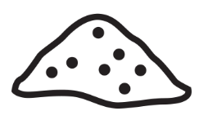

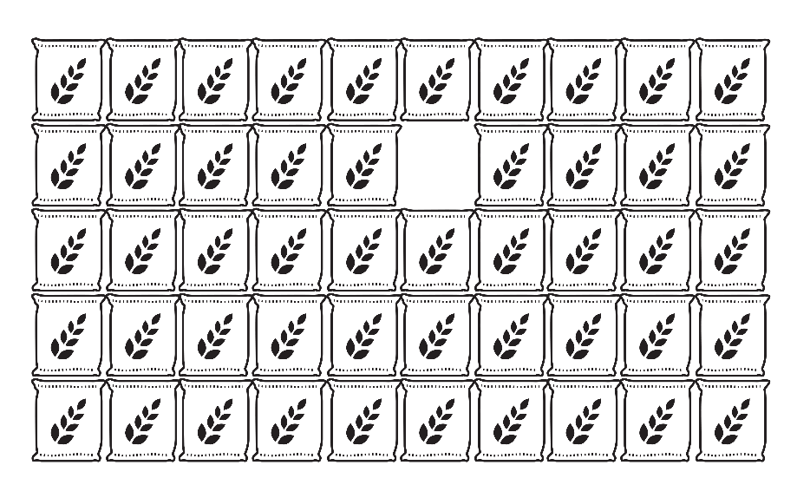
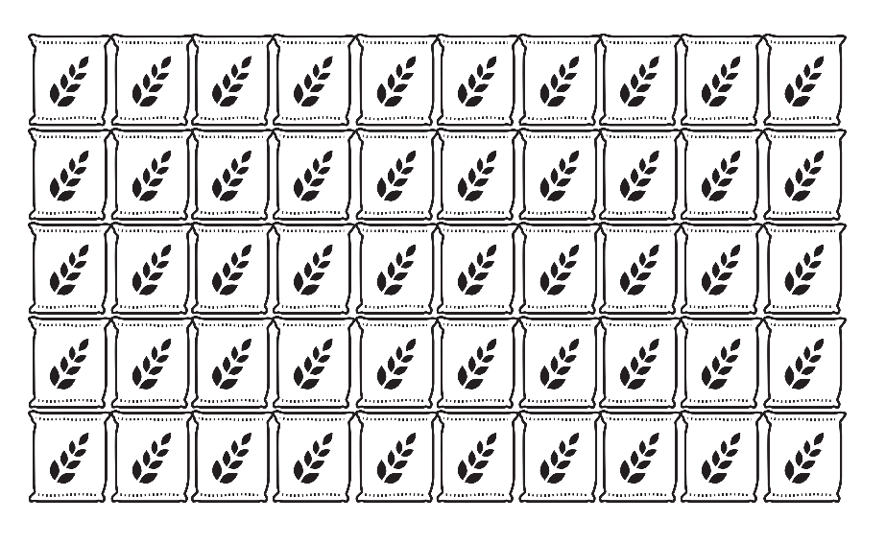
Limitations of sampling plans
Select one 5 lb. bag to sample
Select one 30g sample to test
What if pathogen
is here?
Pallet of 50, 5 lb. bags of flour
(250 lbs. of flour)
5 lb. bag of flour
(2267.96 g of flour)
Or here?
Notes:
You will never be able to test 100% of the product leaving your facility, that is a no brainer. Product testing has limitations due to this fact. Since we are taking a small sub-sample of the product leaving our facility there is always the possibility that we miss the target pathogen of concern. In fact, the probability is high that we will miss a target pathogen through product testing. (Animation) In this very simple example, we are a flour producer that is doing some end product testing for E. coli O121. (Animation) We are pulling one bag sample from each pallet we produce, 50 5 pound bags make up a pallet. (Animation) What if we have one contaminated bag, but we select one for our testing that is not contaminated. (Animation) We also cannot test an entire 5 lb bag for E. coli O121, we have to take a subsample. If we select 30 grams of flour from that 5 pound bag, even if we selected the contaminated bag, (Animation)there is still a change that we miss the pathogen in our subsampling. Also remember that detection limit I mentioned previously, even if we pick the contaminated bag and the contaminated subsample we may still miss the pathogen if it is at a low level that we cannot detect with our analytical method. Hopefully this example gives you some perspective on why we tell you product testing is does not ensure that you have a safe product on your hands.

Slide 5
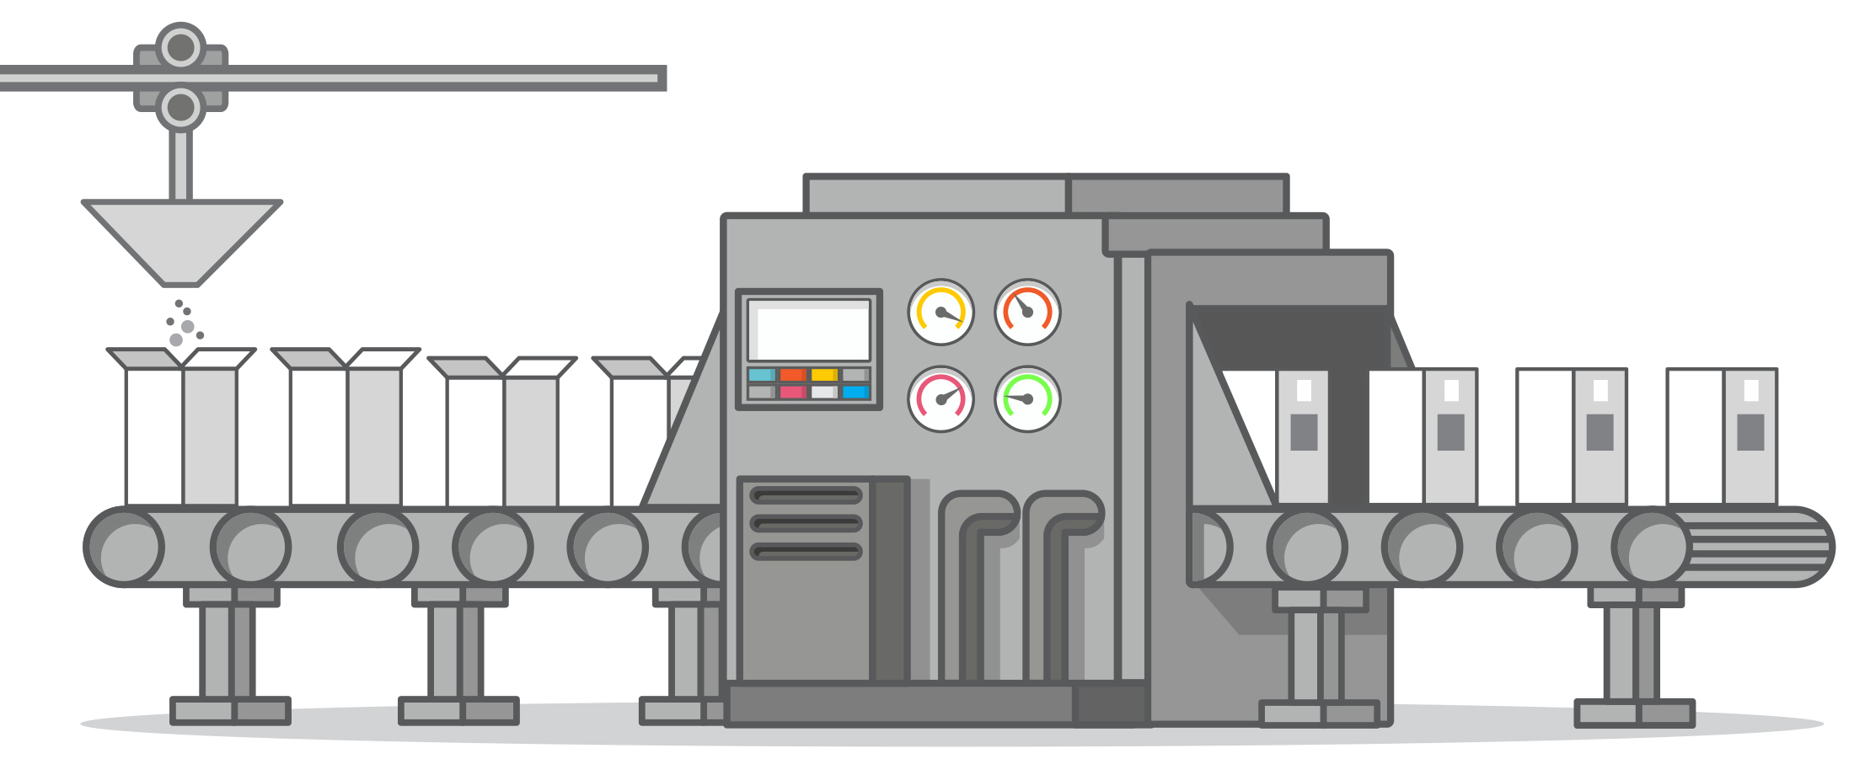
Limitations of sampling plans
When/what
do we test?
Kill Step
Raw Ingredients
Formulated Product
Final Packaged
Product
Notes:
Another complication and limitation plans is determining when and what to test. In this example we have a product that is formulated from raw ingredients, sealed in a package, and then sent through a kill step. Similar to what you may have with a canned product. Here it would make sense that we do a microbial test after the kill step, but what is a better method to ensure that our product is pathogen free? Making sure that our kill step is validated to control those pathogen and verifying the scheduled process is following for each lot of product. However, if you had a very high microbial load coming in on raw ingredients that validated kill step may not be effective, so perhaps some raw ingredient testing would be warranted. A better approach would be to ask your supplier for their validated process as assurance that microbes are controlled. The take home is that there a numerous limitations to product testing and even the best designed sampling plan may not detect a pathogen when it is present.

Slide 6

Summary
A sampling plan should be designed to find pathogens
Microbial testing should be used to verify that cGMPs and Preventive Controls are properly implemented
Product testing does not ensure safety or quality

Slide 7

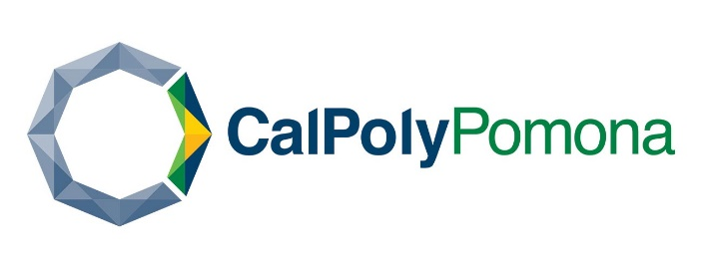




This information is provided by the authors in good faith, but without warranty. It is intended as an educational resource and not as advice tailored to a specific operation or a substitute for actual federal or state regulations and guidance from FDA or other regulatory agencies. We will not be responsible or liable directly or indirectly for any consequences resulting from use of information provided in this document or resources suggested in this document.
This presentation and recording are covered by the University of California Copyright Ownership Policy and were generated by Dr. Erin DiCaprio as Scholarly work.
The development of this material was supported by the National Institute of Food and Agriculture, U.S. Department of Agriculture, under award number 2020-70020-32263. USDA is an equal opportunity employer and service provider. Any opinions, findings, conclusions, or recommendations expressed in this publication are those of the author(s) and do not necessarily reflect the view of the U.S. Department of Agriculture.

