Slide 1

Pathogen Environmental
Monitoring Programs:
Introduction
Notes:
Pathogen Environmental Monitoring Programs: An Introduction

Slide 2
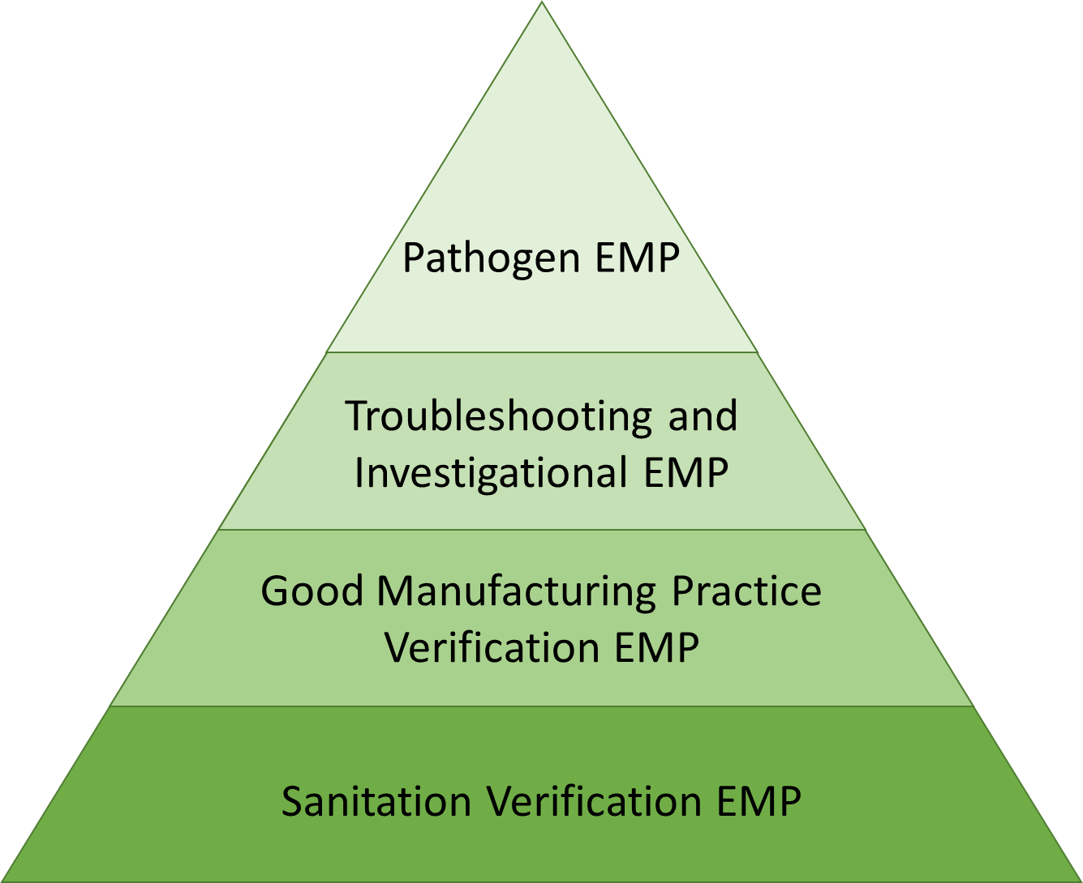
Environmental Monitoring
Programs (EMP)
Environmental pathogen is identified as a hazard
Spoilage issues, pathogen isolation in food
Sanitation Verification EMP
Equipment, surrounding facility
Good Manufacturing Practice
Verification EMP
Evaluation of whole GMP program
Notes:
There are several reasons that you might have an Environmental Monitoring Program or EMP and each is a little different in purpose and scope.
For example you might want to evaluate or verify your entire Good Manufacturing Practices program.
Verify your sanitation program for specific pieces of equipment and perhaps the facility surrounding the equipment
Troubleshooting or investigational EMPs might be used to identify the root cause of a spoilage issue or could be employed after a pathogen isolation in your finished product.
The most specific EMP is the Pathogen Environmental Monitoring Program – this type of program is particularly important when environmental pathogens are a known or reasonably foreseeable biological hazard in your food product.

Slide 3
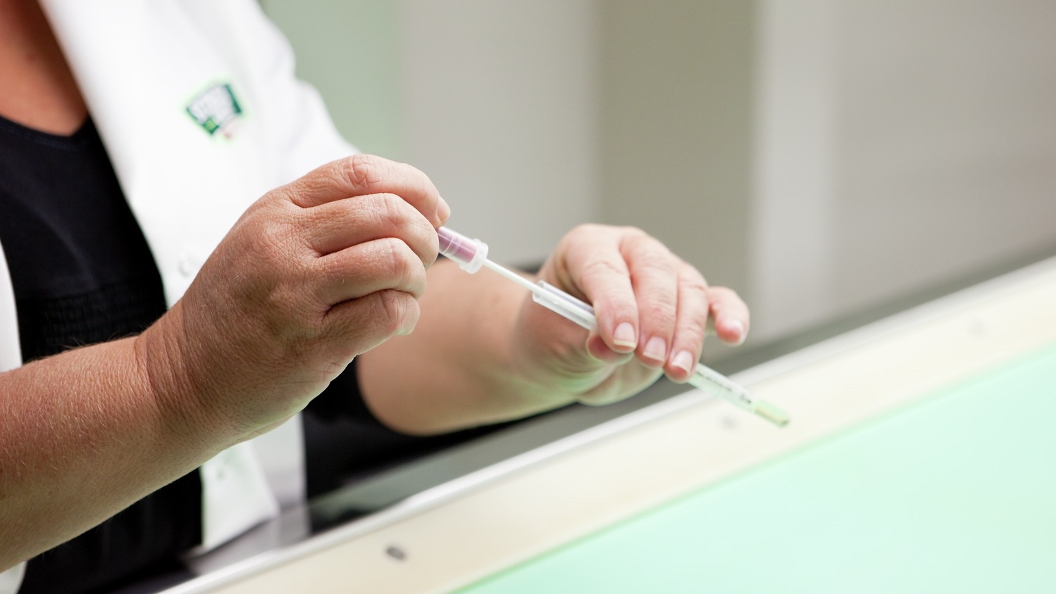
Objectives for EMP Can Differ
Evaluate hygienic design of the facility
Determine if plant maintenance is needed
  E.g., gaskets or filter change
Validation/verification of cleaning and sanitation programs
  Procedures and frequency
Pathogen detection/elimination
  Eliminate niches/harborages
  Known as Pathogen Environmental Monitoring Programs (PEMP)
Notes:
Objectives for EMPs can differ.
You might use an EMP to evaluate the sanitary design of the facility and to determine how easy is it to keep clean and sanitary.
You might want to use an EMP program to help schedule preventive maintenance such as determining the frequency of gasket or filter changes.
You might use EMP programs to validate or verify cleaning and sanitation programs to document that your procedures and their frequency are adequate and appropriate.
Pathogen detection or elimination is focused on identifying potential pathogen niches and working to prevent pathogens from establishing in the facility.
These are known as Pathogen Environmental Monitoring Programs or PEMPs

Slide 4

FSMA
Preventive Controls for Human Foods Rule
Process
Sanitation preventive controls
  Cross-contamination
  Environmental pathogens
Preventive Controls
based on
REQUIRED Hazard Analysis
Food
Allergen
Sanitation
Supplier
Other
Notes:
Pathogen Environmental Monitoring Programs are covered in the Food Safety Modernization Act (FSMA) or”fizzma” Preventive Controls for Human Foods Rule.
The Rule requires that you establish a food safety plan. One of the first steps in preparing a food safety plan is performing a hazard analysis for each food or food category that is produced in your facility.
During that hazard analysis you will determine what types of hazards are relevant to your food product and the environment under which it is produced.
*For known or reasonably foreseeable hazards you will need to establish preventive controls. Sanitation preventive controls are designed to reduce or prevent *cross contamination of finished product with biological hazards and prevent the *establishment of environmental pathogens in your facility. In some cases that will require establishment of a PEMP.

Slide 5

What does FSMA
Preventive Controls Rule Say?
Verification Activity - PEMP
  Environmental monitoring, for an environmental pathogen or for an appropriate indicator organism, if contamination of a ready-to-eat food with an environmental pathogen is a hazard requiring a preventive control, by collecting and testing environmental samples
Notes:
The Preventive Controls Rule considers PEMPs to be a verification activity for
ready-to-eat foods that can become contaminated or re-contaminated with an environmental pathogen

Slide 6
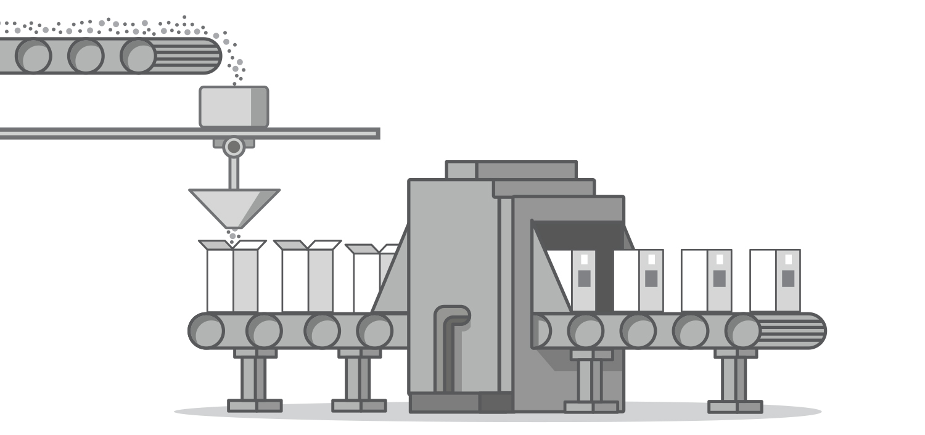
Pathogen EMP (PEMP) – Not Required
Raw Materials
No Environmental Exposure
Of Finished Product
Package Sealed
Validated Kill Step
Final
Packaged Product
Filling
Notes:
This cartoon provides an example of a ready-to-eat food where environmental pathogens are NOT not likely or reasonably forseeable. In this example the raw materials are mixed together and filled into the final package. The packages are sealed and proceed through a validated cook step or kill step. The key feature of this process is that the finished product is not exposed to equipment surfaces or the processing environment after the kill step is applied. A canned or jarred product that goes into a retort or steam tunnel is an example of this type of food product. In this case a PEMP is not required.

Slide 7
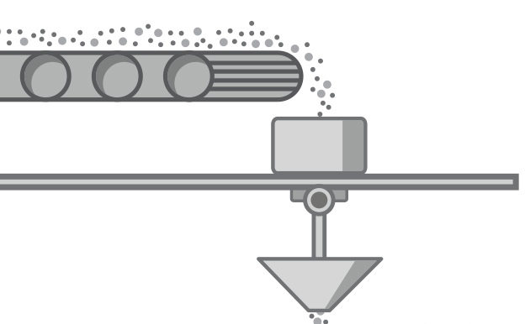

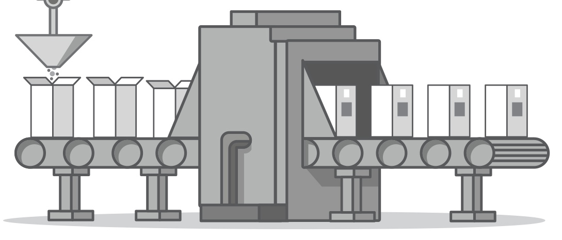

Raw Materials
Pathogen EMP (PEMP) Likely Required
Validated Kill Step
Environmental
Exposure
Package Sealed
Final
Packaged Product
Notes:
This cartoon provides an example of a ready-to-eat food where contamination with environmental pathogens IS a concern. In this case the raw materials are mixed together and a kill step is applied. The finished product is then exposed to equipment surfaces and the processing environment BEFORE the package is filled and sealed. After sealing, no further kill step is applied. An example of this type of product might be a roasted nut – after the nuts leave the roaster they travel on a conveyer belt while they cool. The final package is then filled with the cooled nuts and the package is sealed. The sealed package doesn’t undergo any further processing. In this example a Pathogen Environmental Monitoring program is likely required.

Slide 8
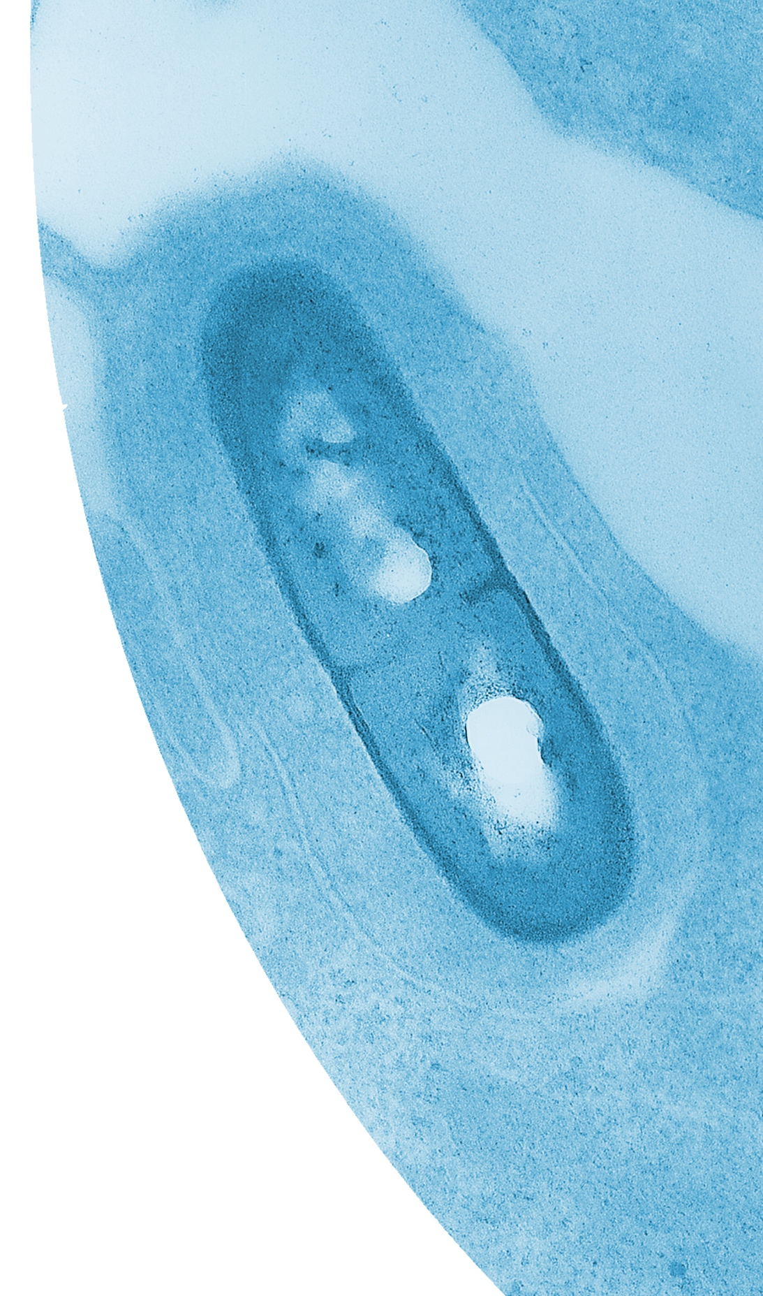
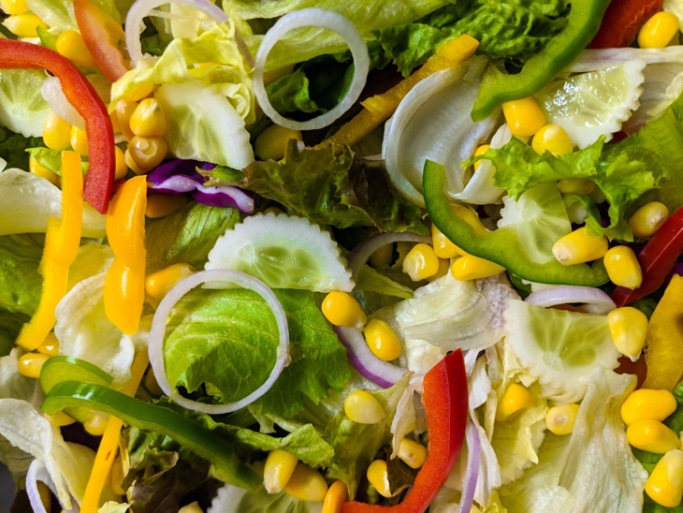


Listeria monocytogenes
Listeria monocytogenes is the target organism for environmental monitoring of product-contact and non-product contact surfaces in a wet ready-to-eat food manufacturing facility
Notes:
FDA has identified specific pathogens of concern for environmental contamination based on a history of foodborne outbreaks and product recalls. The ability for a pathogen to establish in a facility is related to the presence of moisture, adequate nutrients, and an appropriate temperature. When foods are high in moisture and are produced in environments where water is used for routine cleaning and sanitation the pathogen of concern is Listeria monocytogenes. A large group of foods fall into this category including frozen foods like vegetables, prepared meals, and ice cream, and refrigerated foods such as dairy products, prepared salads, some types of beverages.

Slide 9
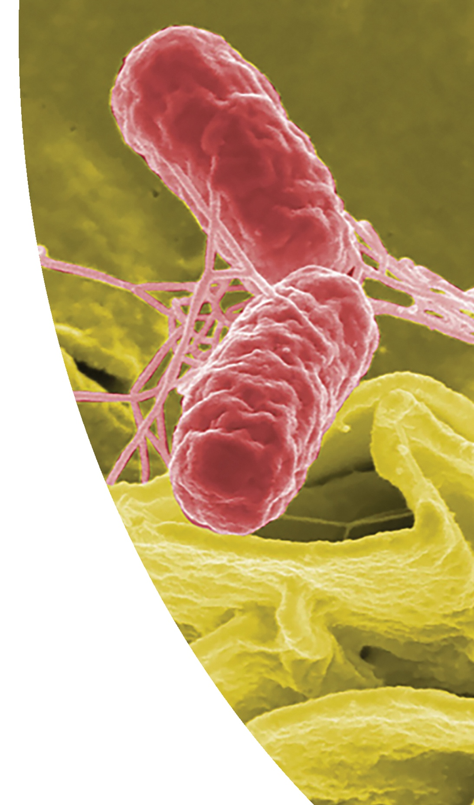
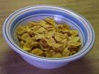

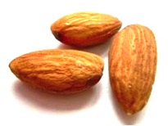
Salmonella
Salmonella is the target organism for environmental monitoring of
product-contact and non-product contact surfaces in a
dry (low-moisture) ready-to-eat
food manufacturing facility
Notes:
When low-moisture foods are produced in dry environments, the pathogen of concern is Salmonella. This includes many types of cereal products, baked goods, powders like spices and instant beverages, nuts and seeds, and chocolates and confections.

Slide 10

Summary
There are several types of environmental monitoring programs that differ in their objectives
The Preventive Controls for Human Foods Rule
  Verification activity
    pathogen environmental monitoring programs (PEMP)
    contamination of ready-to-eat food a hazard needing a preventive control
Target organisms in PEMP
  Listeria monocytogenes (wet)
  Salmonella (dry)
Notes:
In summary, there are several types of environmental monitoring programs and the structure and outcomes or objectives of each will differ.
The Preventive Controls for Human Foods Rule requires that Pathogen Environmental Monitoring programs be established as a verification activity when the hazard analysis determines that contamination of ready-to-eat foods with an environmental pathogen is a hazard that needs a preventive control.
Listeria monocytogenes and Salmonella are target pathogens for PEM programs in wet and dry facilities.

Slide 11

This information is provided by the authors in good faith, but without warranty. It is intended as an educational resource and not as advice tailored to a specific operation or a substitute for actual federal or state regulations and guidance from the U.S. Food and Drug Administration (FDA) or other regulatory agency. We will not be responsible or liable directly or indirectly for any consequences resulting from use of information provided in this document or resources suggested in this document.
This presentation and recording are covered by the University of California Copyright Ownership Policy and were generated by Dr. Linda J. Harris as Scholarly work.
The development of this material was supported by the National Institute of Food and Agriculture, U.S. Department of Agriculture, under award number 2018-70020-28861-0. USDA is an equal opportunity employer and service provider. Any opinions, findings, conclusions, or recommendations expressed in this publication are those of the author(s) and do not necessarily reflect the view of the U.S. Department of Agriculture.

