Slide 1

Microbiological Testing of Foods:
Target Microorganisms

Slide 2


What microorganisms should be tested for and when?
Target microorganism
  Utility microorganism
  Indicator microorganism
  Pathogenic microorganism
Product stage
  Final product
  Ingredients
  In-process
  Environmental samples
Notes:
Determining the microorganisms to test for and what stage in process to test will vary for different products and processes. We’ll talk more in depth about the different microbial targets and the impact of targeting different product stages in the webinar. It is up to you as the processor to determine what and when you should be testing. There are many sources to reference for a small processor. These include FDA guidance documents, publications from trade/industry organizations, university extension resources, and many others. That being said, there are certain requirements that you will be held to either by your buyers or by regulatory agencies. Again, as a food manufacturer if is up to you to determine what these requirements include for your product. For example, the Food Safety Modernization Act Preventive Controls for Human Food Rule does not require microbial testing in the regulatory language. However, as a processor you or your supplier will be utilizing microbial testing as part of your Supply Chain Preventive Controls. You will also be utilizing microbial testing to verify Process Preventive Controls. In addition, if you are producing a product that requires a Sanitation Preventive Control for environmental pathogens (Listeria monocytogenes or Salmonella). Many of these activities likely will be also be part of your QA program as they directly impact the quality of your product.

Slide 3

Utility microorganism testing
Uses:
  General contamination
  Incipient spoilage
  Reduced shelf life
Types of tests:
  Direct microscopic counts
  Yeast and mold counts
  Aerobic plate counts
  Others (specialized for specific types of spoilage microorganisms)
Notes:
Utility organism testing is typically a part of QA programs. These types of tests are routinely used for verification of cleaning and sanitation. Examples are aerobic plate counts (APC) and yeast and mold counts. These tests do not look for a specific microorganism but test for a broad range or a class of microbes. The results give you a general picture of the microbial levels of the food or the environment. The “acceptable” level for utility microorganisms tests will again vary based on the product and process, but in general high results can indicate a contamination issue. This could result in quality issues including reduced shelf life or incipient spoilage. While not directly detecting presence of a pathogens, high utility microorganism levels suggest conditions are favorable for microbial survival and/or growth leading to an increased risk for pathogens to be present.

Slide 4

Indicator microorganism testing
Non-pathogenic microorganisms that may indicate presence of a pathogen
Relationship between pathogen and indicator are not universal
Uses:
  Trend analysis
  Verification of process control
  Efficacy of cleaning and sanitation
  Investigational sampling
Types of indicators:
  Enterobacteriaceae
  Coliforms
  Fecal coliforms
  Generic Escherichia coli
  Others
Enterobactericeae
Pathogenic E. coli, Salmonella, Shigella
Total Coliform
Fecal Coliform
Generic E. coli
Pathogenic E. coli
Notes:
Many QA programs also include testing for one or more indicator organisms. Indicator organisms are non-pathogenic microorganisms, but these microorganisms are closely related to pathogens. They grow under very similar conditions to pathogens and have a similar reservoir, or source, as the pathogens. Therefore a positive test result for an indicator organism may indicate the presence of the pathogen. Unfortunately, there is not a 1 for 1 relationship between detection of an indicator organism and a pathogen. Meaning that a positive indicator test does not always mean a pathogen is present and a negative indicator test does not mean a pathogen is absent. Common indicator organisms are listed on this slide, they are ordered from most generic to most specific. Enterobacteriaceae, commonly called Ebac or EB, is a family of bacteria that includes some relevant pathogens such as STEC and Salmonella. Coliforms are a subset of Entercateriaceae and fecal coliforms is a more specific type of coliforms. Within fecal coliforms, a more specific test would be for generic E. coli. When it comes to Listeria monocytogenes the most common indicator used is Listeria species. As part of your hazard analysis you will have identified microbial pathogens of concern for your product and process. You can then select an appropriate indicator based on the microbial hazard that was identified.

Slide 5
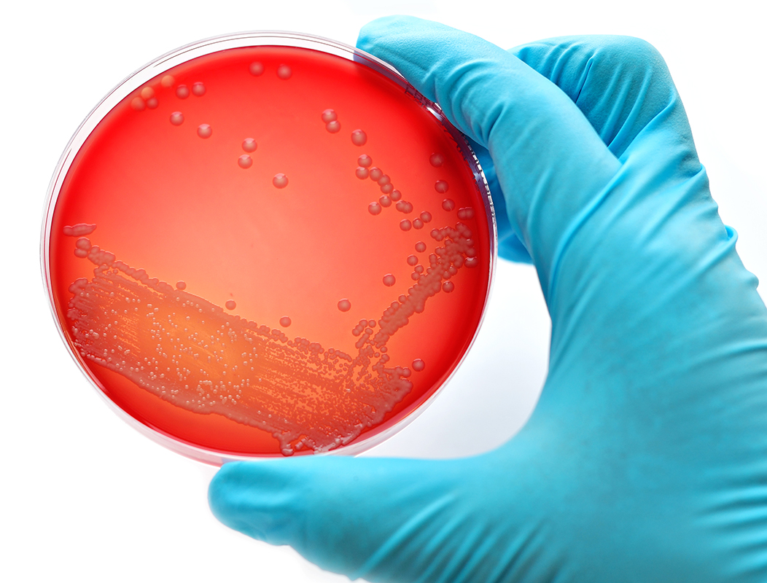
Pathogenic microorganism testing
Direct testing for the pathogen of concern
Pathogens tested:
  Escherichia coli O157:H7
  Salmonella spp.
  Listeria monocytogenes
  others
Notes:
One may also opt to directly test for the pathogen of concern in foods or the environment. This may be a regulatory requirement (depending on your product, mostly for USDA regulated products) or be a buyer requirement. If a pathogen test is positive all product in the associated lot must be recalled. A positive result will also initiate a root cause analysis to determine what lead to the positive test result. We will talk about the limitations of microbial testing, but I will mention here that a negative result does not necessarily mean that your product is free of the target pathogen. Ensuring that GMPs and your validated processes are followed are much better at indicators that your product will be free of pathogens than final product testing.

Slide 6

Summary
Utility microorganisms testing (APC, yeast and mold counts) are used for routine product and environmental testing
Indicator microorganisms are used to determine if a pathogen might be present in food or the environment
Direct pathogen tests are used to determine if a pathogen is present in food or the environment

Slide 7

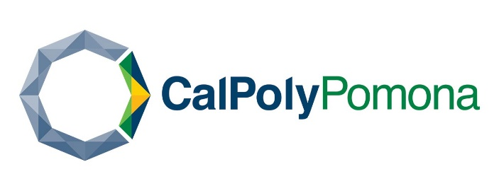




This information is provided by the authors in good faith, but without warranty. It is intended as an educational resource and not as advice tailored to a specific operation or a substitute for actual federal or state regulations and guidance from FDA or other regulatory agencies. We will not be responsible or liable directly or indirectly for any consequences resulting from use of information provided in this document or resources suggested in this document.
This presentation and recording are covered by the University of California Copyright Ownership Policy and were generated by Dr. Erin DiCaprio as Scholarly work.
The development of this material was supported by the National Institute of Food and Agriculture, U.S. Department of Agriculture, under award number 2020-70020-32263. USDA is an equal opportunity employer and service provider. Any opinions, findings, conclusions, or recommendations expressed in this publication are those of the author(s) and do not necessarily reflect the view of the U.S. Department of Agriculture.

