Slide 1
Microbiological Testing of Foods: Microorganisms in food

Slide 2
Microorganisms in food
Molds
Bacteria
Parasites
Yeast
Viruses
Notes:
The field of microbiology includes diverse organisms from different domains of life. Parasites, fungi, and yeasts represent eukaryotic, organisms with a nucleus within their cells. They may be unicellular or multicellular organisms. Bacteria are single celled organisms that lack a nucleus. Viruses are actually not living organisms, as they are obligate intracellular parasites. Collectively these diverse organisms are termed germs, microbes, microorganisms, bugs, among other names. Microorganisms are important in a number of fields including medicine, agriculture, chemical and food industries.

Slide 3
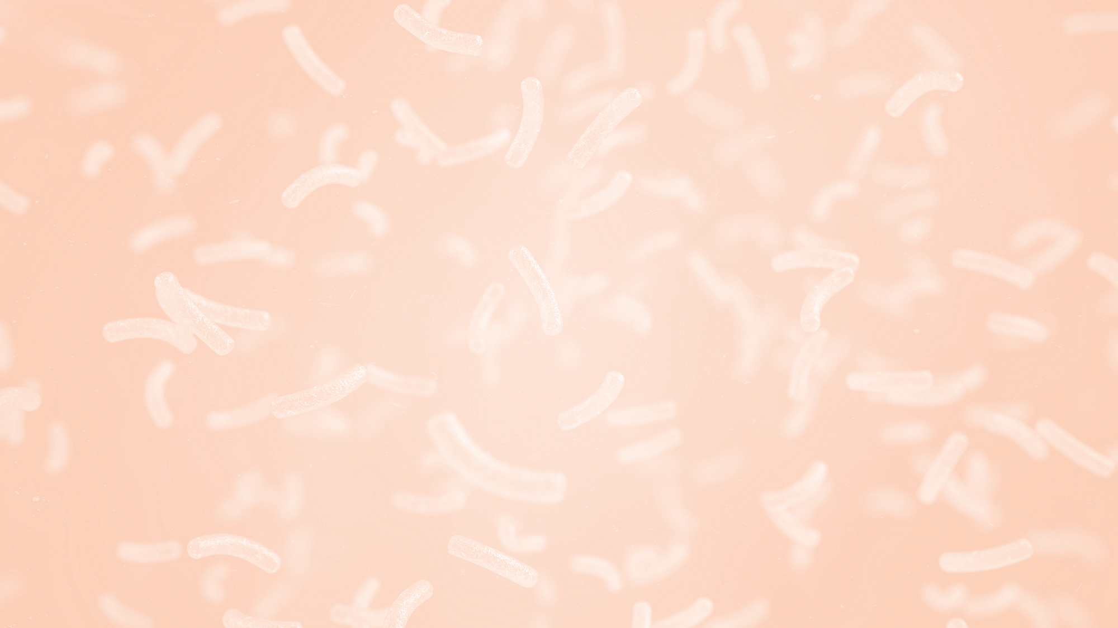
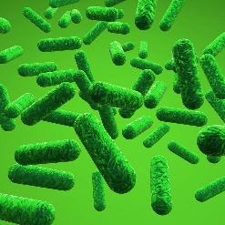
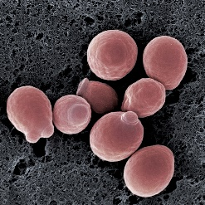
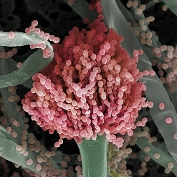
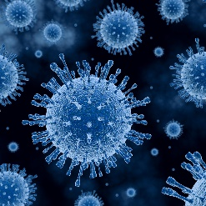
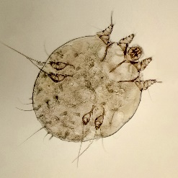
Microorganisms in food
Foodborne Illness | ✔ |  | * | ✔ | ✔
Fermentation | ✔ | ✔ | ✔
Spoilage | ✔ | ✔ | ✔
bacteria
yeasts
molds
viruses
parasites
*Some molds can produce a mycotoxin in certain foods.
Notes:
This slide lists the types of microorganisms important to foods. They are categorized as either contributors of food spoilage, foodborne illness, or food enhancement. Bacteria are the most important group of microorganisms to consider because they contribute significantly to food safety, food spoilage, and fermentation. Therefore they are often a frequent target for microbial testing. Molds and yeasts are also targeted because of their association with spoilage. Viruses and parasites are not included in most microbial testing schemes and are often only tested for in an outbreak investigation.
It is important to understand that different types of microorganisms have differing test methods. There are general microbial tests, such as an aerobic plate count (APC), that will test broadly for a general category of microorganisms. In this case, all aerobic bacteria. There are also selective tests that test for specific organisms. It is important to understand the different targets and associated methods for any microbiological testing program.

Slide 4
Why test for microorganisms?
To reach a decision or make a judgement related to:
Safety
Adherence to Good Manufacturing Practices (GMPs)
Raw ingredient utility
Shelf life
Notes:
The first thing that often comes to mind when we think of microbiological testing of foods is safety. Microbial pathogens, most notably bacteria, are often the cause of food borne illness and therefore often are the target or microbial testing regimes. An example would be testing for E. coli O157:H7 in final product. Microbial testing may also be used to determine whether GMPs are being followed. An example would be aerobic plate count conducted on non food contact surfaces after cleaning and sanitation. Microbial counts are often used to determine the quality of raw ingredients and can indicate the ability to use raw ingredients for a specific purpose. For example, an ingredient in yogurt with a high microbial load may interfere with fermentation. Finally microbial testing can be used to determine the shelf life of a food. Testing for levels of spoilage molds, yeasts, and bacteria can help one predict how long a product will be stable during storage. Another important reason to do routine microbial testing is to gather baseline data. This allows you to determine your microbial action levels later on. Also important for trace back investigation in the case of a recall.

Slide 5
Who tests for microorganisms?
Government
Lot inspection/verification
Lot acceptance
Surveillance
Investigational
Industry
Product design
Verify process controls (food safety and spoilage)
Investigational
Notes:
As a food processor you will be conducting microbial testing in some capacity. Microbial testing is an import aspect to consider when going through the product development process. Understanding the microbial load and impact of product formulation on the growth or inhibition of growth of microorganisms will ultimately drive decision making. Often, microbial testing is used to verify that a process control is effective. For example, a producer of pickled beets may routinely test final product for both spoilage and pathogenic organisms to ensure that the acidification and heat treatment are effectively eliminating these organisms. Microbial testing can also be used to assist in root cause analysis. If a fermentation is consistently failing, microbial testing may point to an ingredient with a high initial microbial count that is outcompeting the fermentation organisms. Environmental microbial testing can also help point to a source of contamination that occurs after a kill step, leading to either food safety or spoilage issues.

Slide 6
Summary
Microorganisms include: fungi (molds and yeasts), parasites, bacteria, and viruses
Microorganisms can cause spoilage or safety issues or be used beneficially in food production
Reasons for microbial testing include safety, adherence to Good Manufacturing Practices (GMPs), raw ingredient utility, shelf life

Slide 7
This information is provided by the authors in good faith, but without warranty. It is intended as an educational resource and not as advice tailored to a specific operation or a substitute for actual federal or state regulations and guidance from FDA or other regulatory agencies. We will not be responsible or liable directly or indirectly for any consequences resulting from use of information provided in this document or resources suggested in this document.
This presentation and recording are covered by the University of California Copyright Ownership Policy and were generated by Dr. Erin DiCaprio as Scholarly work.
The development of this material was supported by the National Institute of Food and Agriculture, U.S. Department of Agriculture, under award number 2020-70020-32263. USDA is an equal opportunity employer and service provider. Any opinions, findings, conclusions, or recommendations expressed in this publication are those of the author(s) and do not necessarily reflect the view of the U.S. Department of Agriculture.

